Slide 1



Dynamical neuronal networks
Neurocomputation Workshop
Neurasmus Summer School
2025 July 2nd - 5th, Berlin, Germany
Patrick Desrosiers
Dynamica Research Lab
CERVO Brain Research Center
Département de physique, de genie physique et d’optique, Université Laval

Slide 2
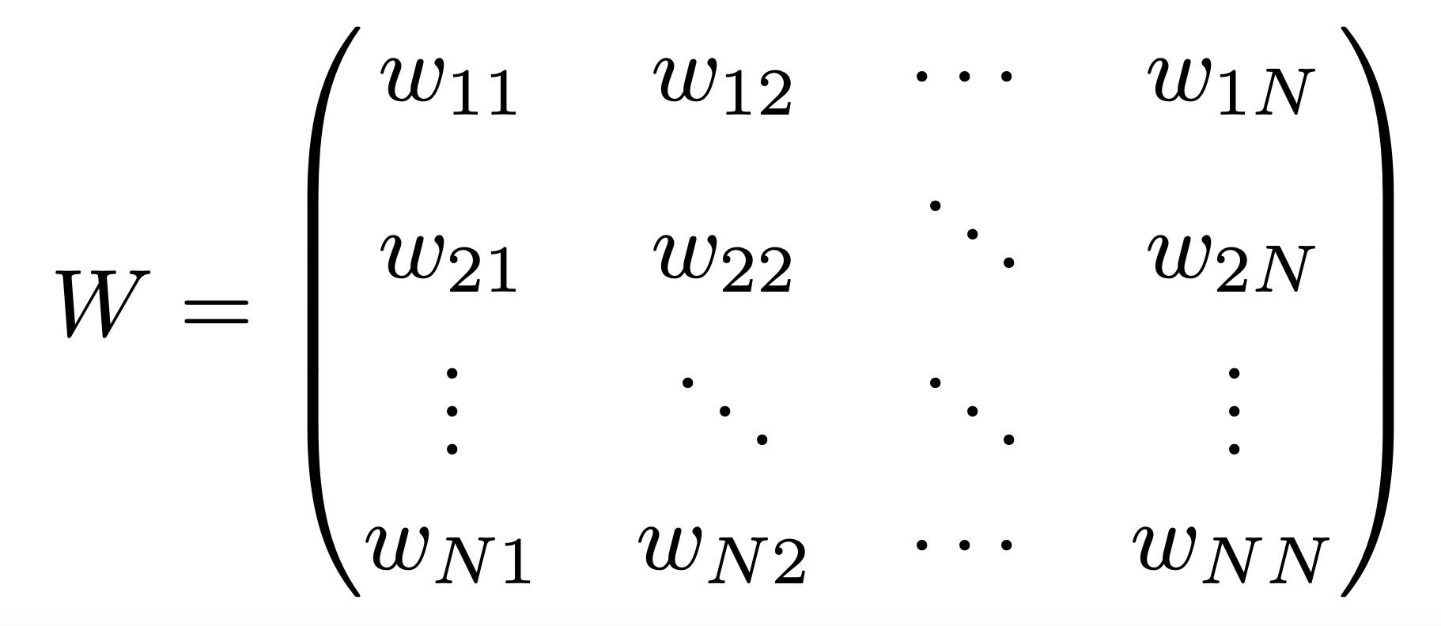
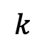
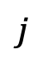
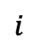
Reminder:
Neuronal networks are first modeled as weighted directed graphs
$$j$$
Synonyms:
Adjacency matrix
Weight matrix
Connectivity matrix
$$i$$
$$k$$

Slide 3

Neuronal activity models
Lapicque (1907)
McCulloch & Pitts (1943)
Hodgkin & Huxley (1952)
Amari (1972)
Little (1974)
Wilson & Cowan (1972)
Cohen & Grossberg (1983)
Hopfield (1982 & 1984)
…

Slide 4
Neuronal activity models
Lapicque (1907)
McCulloch & Pitts (1943)
Hodgkin & Huxley (1952)
Amari (1972)
Little (1974)
Wilson & Cowan (1972)
Cohen & Grossberg (1983)
Hopfield (1982 & 1984)
…
Will be studied during out next computer lab:
Attractors and Hopfield networks.

Slide 5
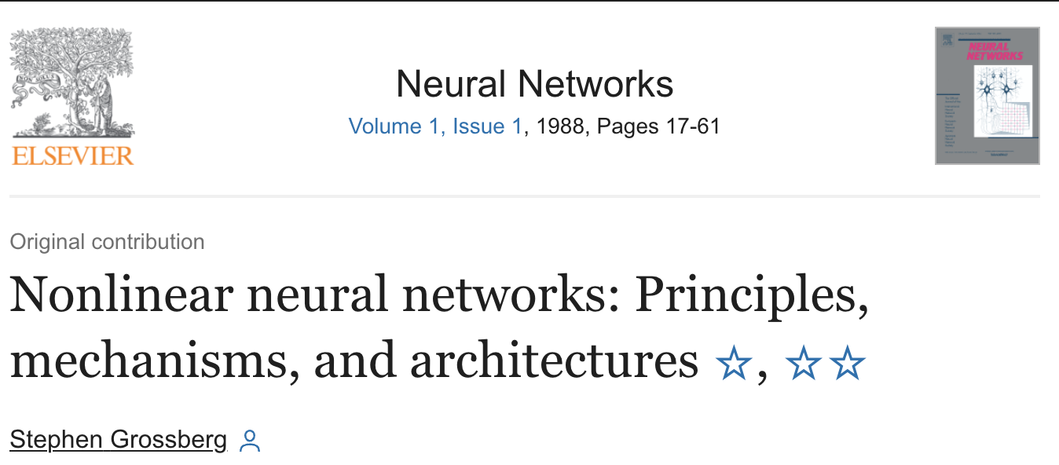

Neuronal activity models
Lapicque (1907)
McCulloch & Pitts (1943)
Hodgkin & Huxley (1952)
Amari (1972)
Little (1974)
Wilson & Cowan (1972)
Cohen & Grossberg (1983)
Hopfield (1982 & 1984)
…
Characterized as continuous-nonlinear, firing-rate or rate-based models

Slide 6
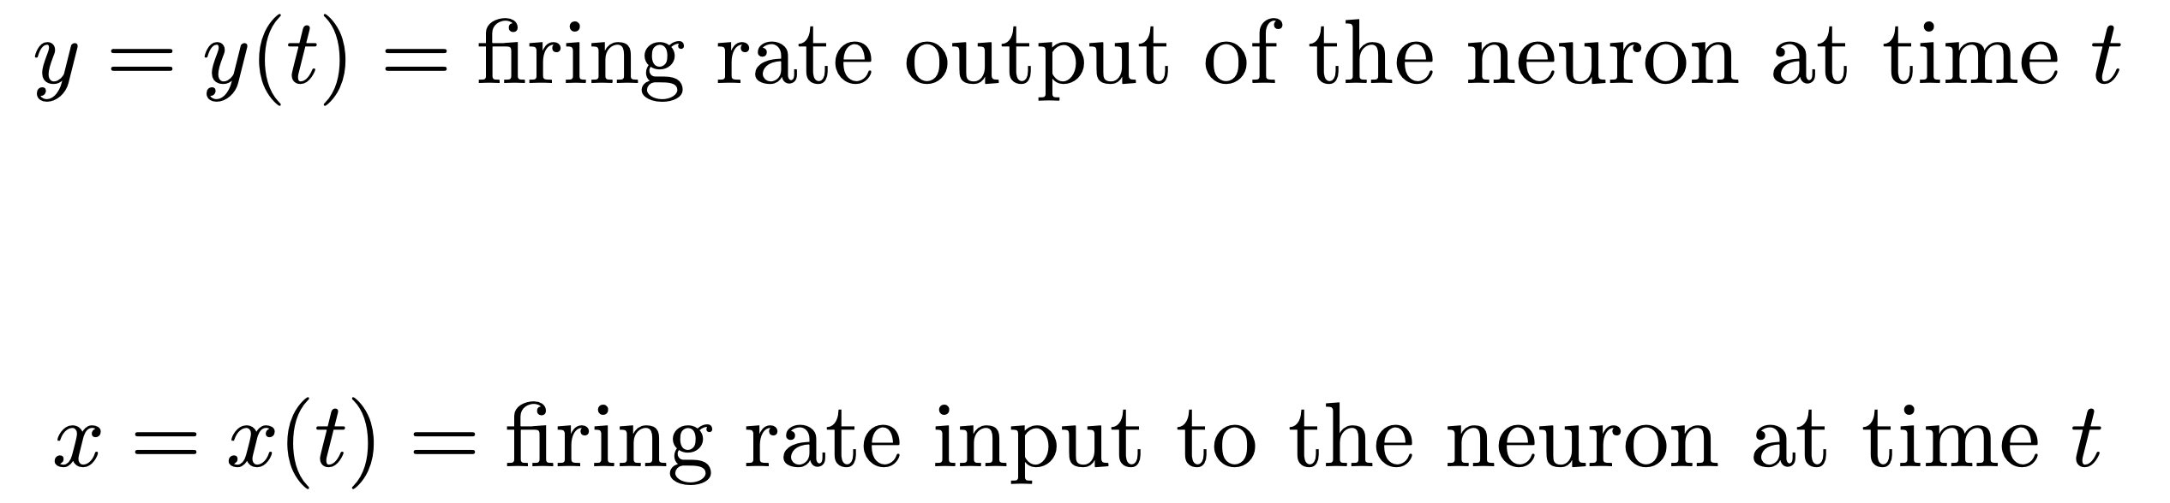
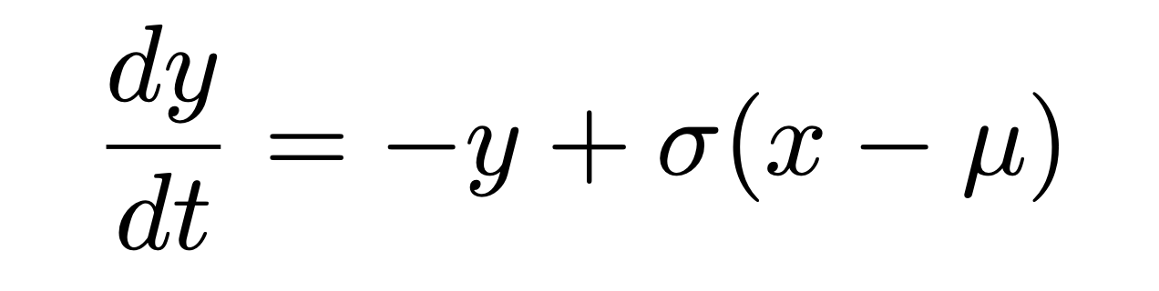
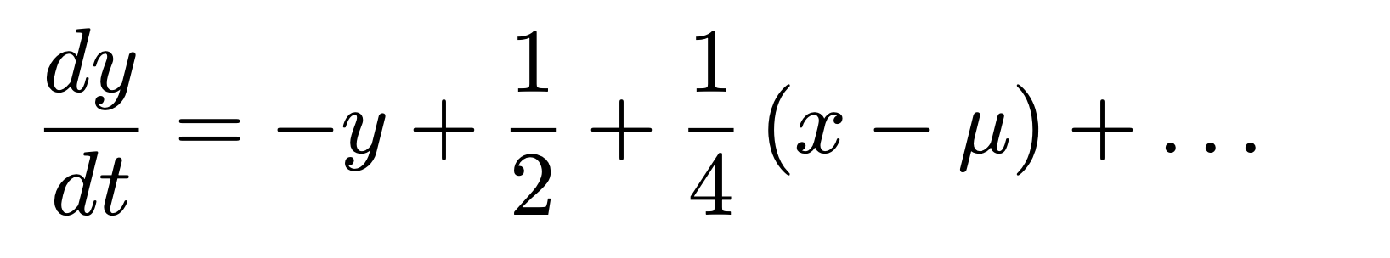
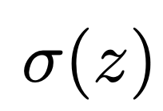

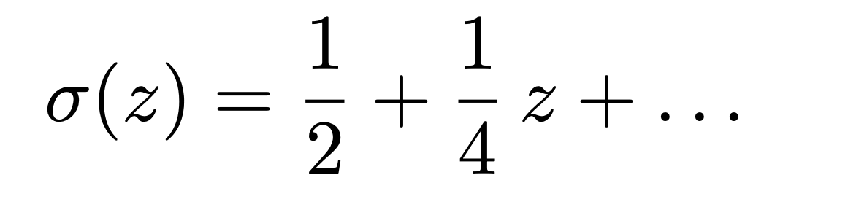
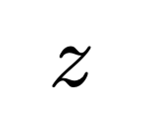
Neuronal activity models
Lapicque (1907)
McCulloch & Pitts (1943)
Hodgkin & Huxley (1952)
Amari (1972)
Little (1974)
Wilson & Cowan (1972)
Cohen & Grossberg (1983)
Hopfield (1982 & 1984)
…
Linear regime
Threshold
Activation function

Slide 7
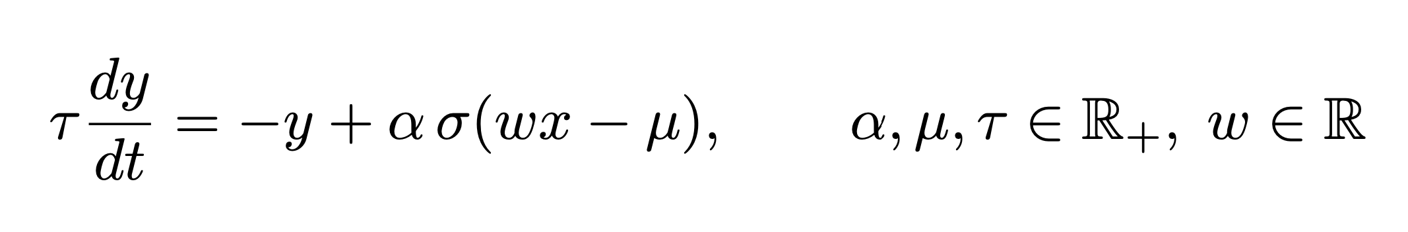
Neuronal activity models
Lapicque (1907)
McCulloch & Pitts (1943)
Hodgkin & Huxley (1952)
Amari (1972)
Little (1974)
Wilson & Cowan (1972)
Cohen & Grossberg (1983)
Hopfield (1982 & 1984)
…
Time constant
Threshold
Weight
Activation amplitude

Slide 8
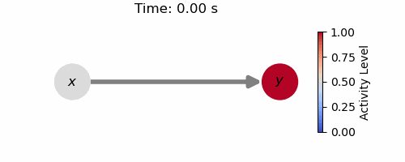
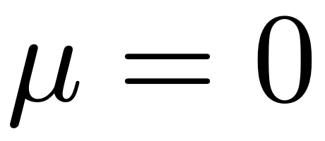

Neuronal activity models
Lapicque (1907)
McCulloch & Pitts (1943)
Hodgkin & Huxley (1952)
Amari (1972)
Little (1974)
Wilson & Cowan (1972)
Cohen & Grossberg (1983)
Hopfield (1982 & 1984)
…

Slide 9
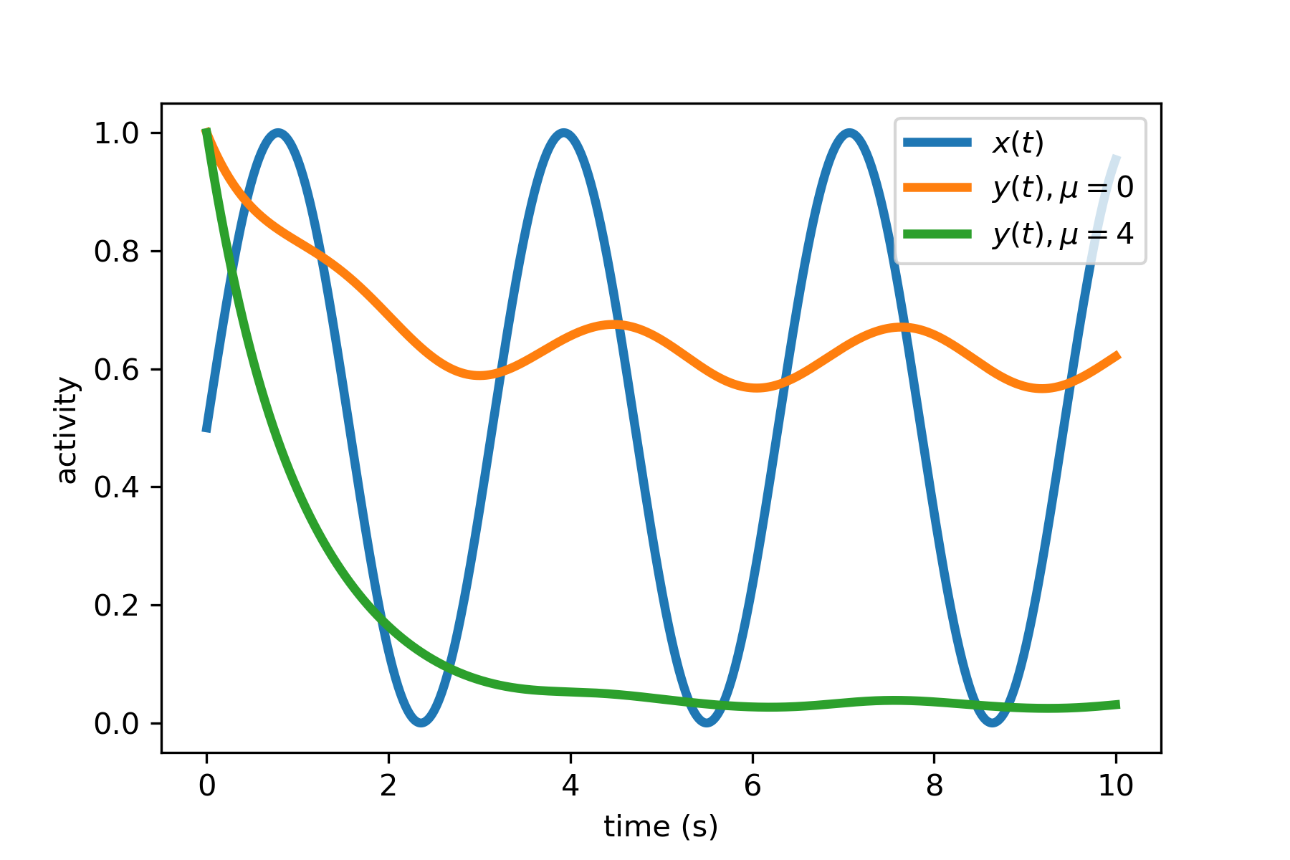
Neuronal activity models
Lapicque (1907)
McCulloch & Pitts (1943)
Hodgkin & Huxley (1952)
Amari (1972)
Little (1974)
Wilson & Cowan (1972)
Cohen & Grossberg (1983)
Hopfield (1982 & 1984)
…

Slide 10
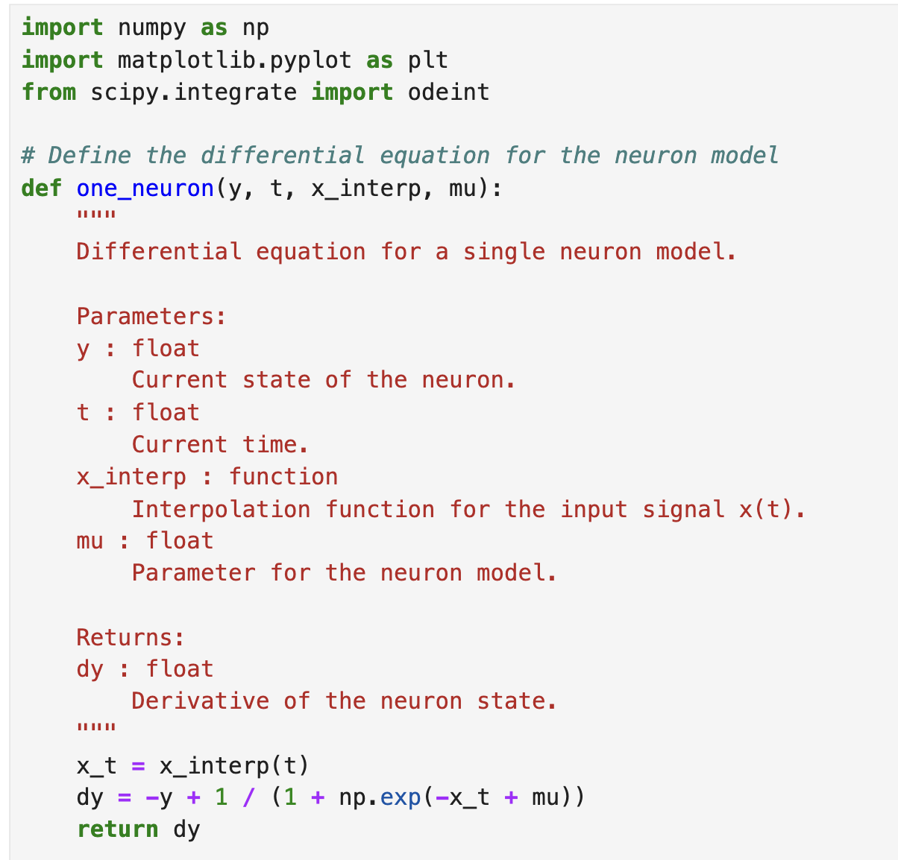

Slide 11
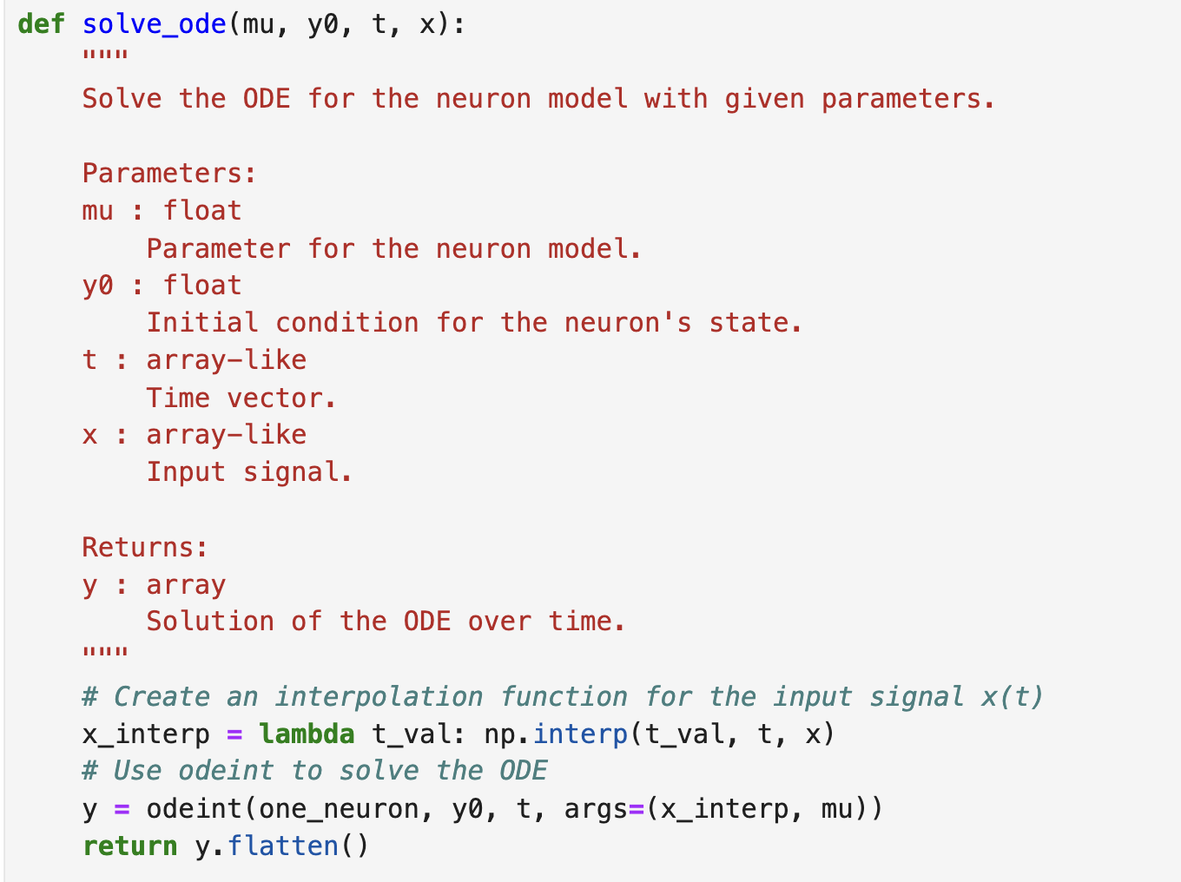

Slide 12
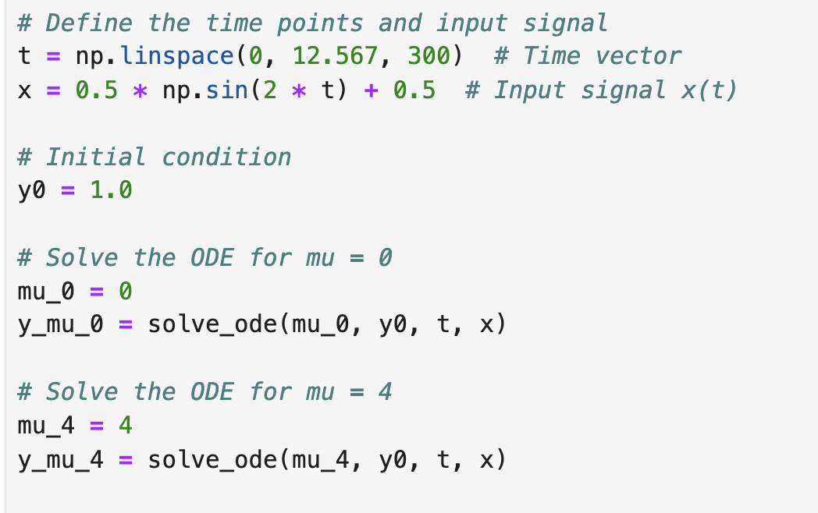

Slide 13
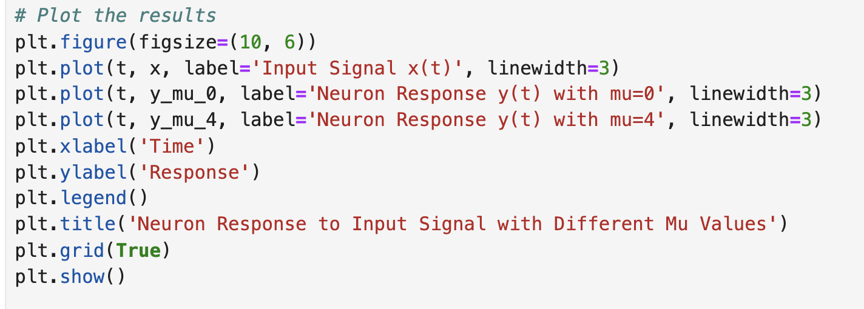

Slide 14
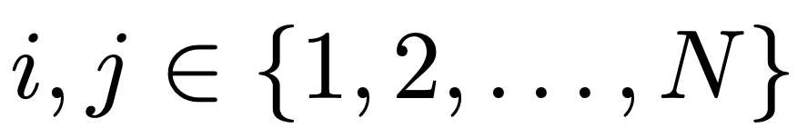
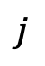
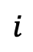
Network activity model
$$j$$
$$i$$

Slide 15
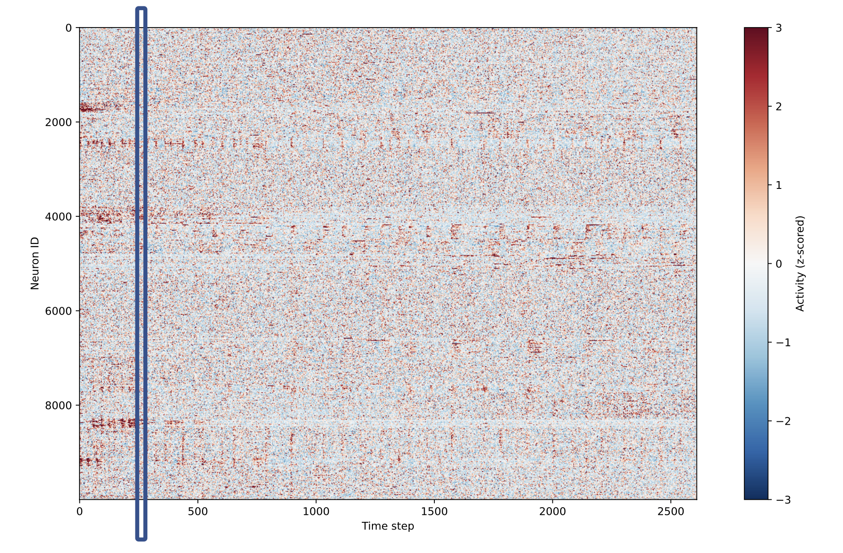

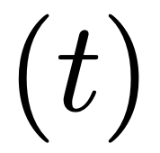
Network state at time t:

Slide 16
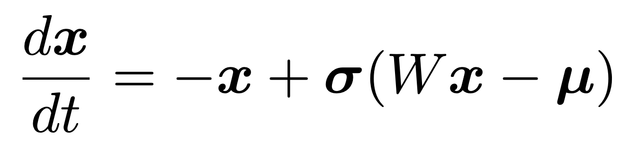
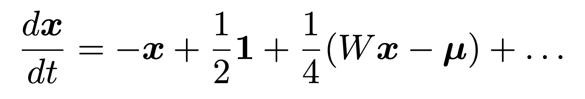
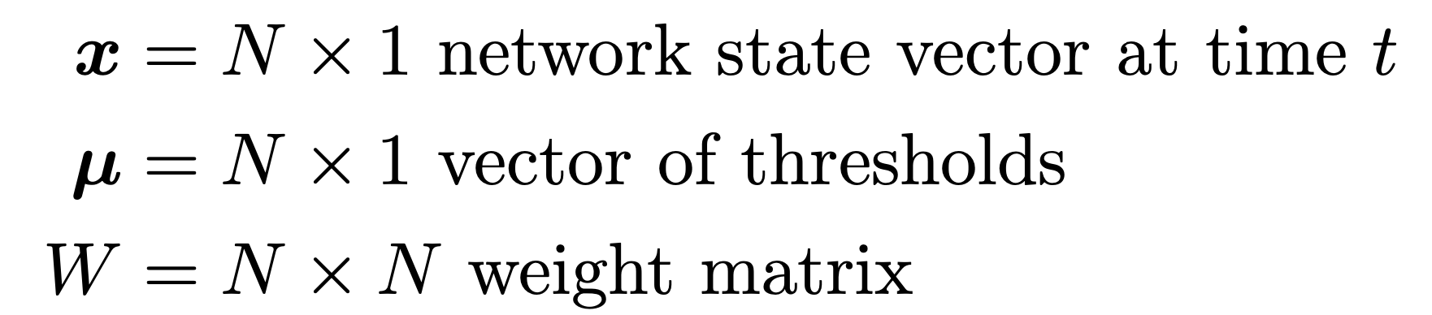
Network activity model
Linear regime
$$j$$
$$i$$
This is a complex dynamical system:
high dimensional, heterogeneous, and nonlinear.
This is a complex dynamical system:
high dimensional, heterogeneous, and linear.

Slide 17



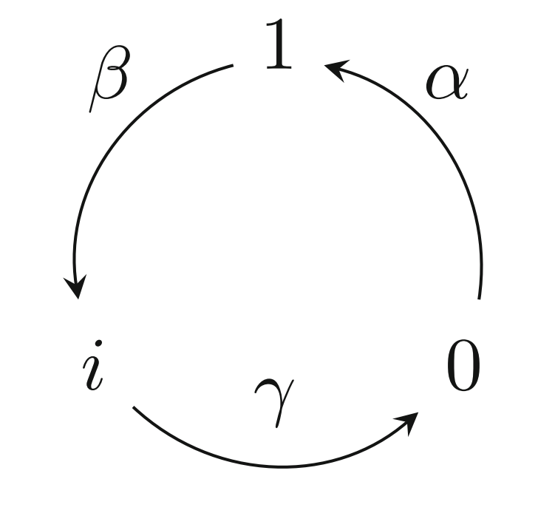
Network activity model
$$j$$
$$i$$
This deterministic dynamical system emerges from the stochastic response of neurons to stimuli.
active
refractory
sensitive

Slide 18
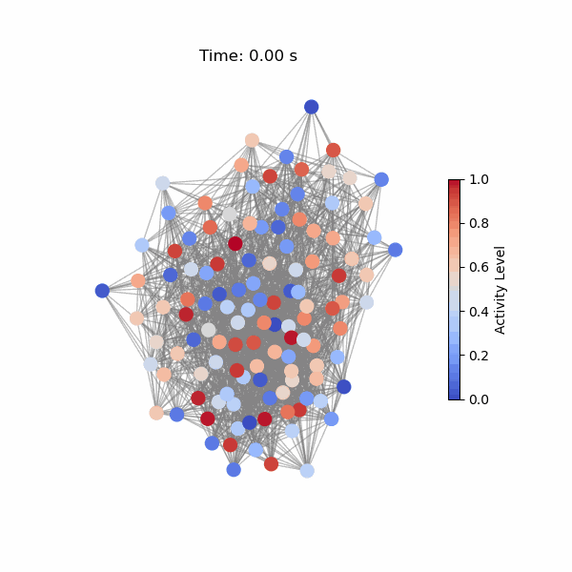
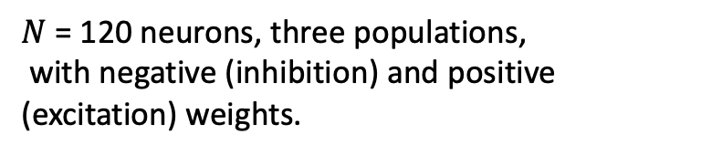
Network activity model:
Simple nonlinear example
$N$ = 120 neurons, three populations,
with negative (inhibition) and positive (excitation) weights.
W =

Slide 19
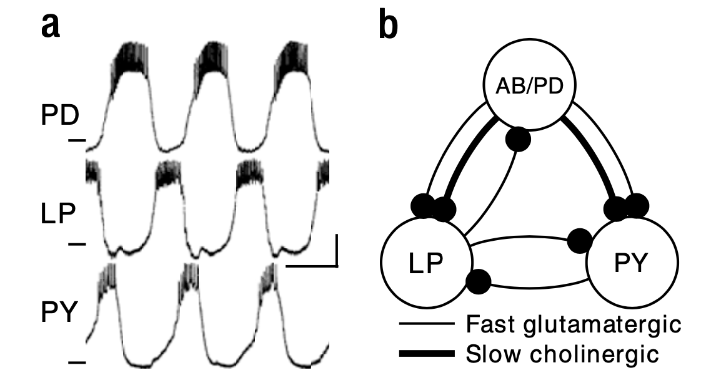
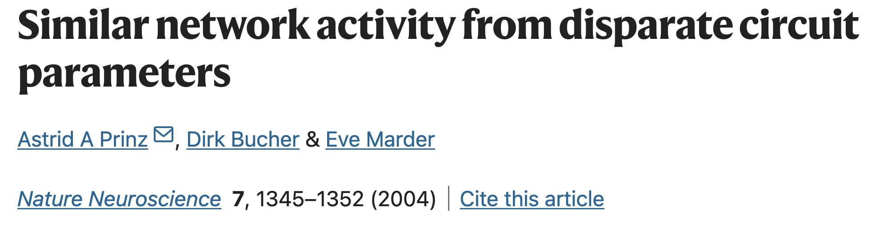

Two important lessons from neuroscience and network science:
1. Many structures produce the same function.
Pyloric rhythms of the crustacean stomatogastric ganglion and a simplified version of underlying neuronal circuit.
The main result of our analysis of the database of over 20 million network models is that similar network outputs can be generated with a large variety of combinations of synaptic strengths and intrinsic neuronal properties.
The true topology is not needed for predicting dynamics on networks, since the dynamics evolve in a subspace of astonishingly low dimension compared to the size and heterogeneity of the graph.

Slide 20

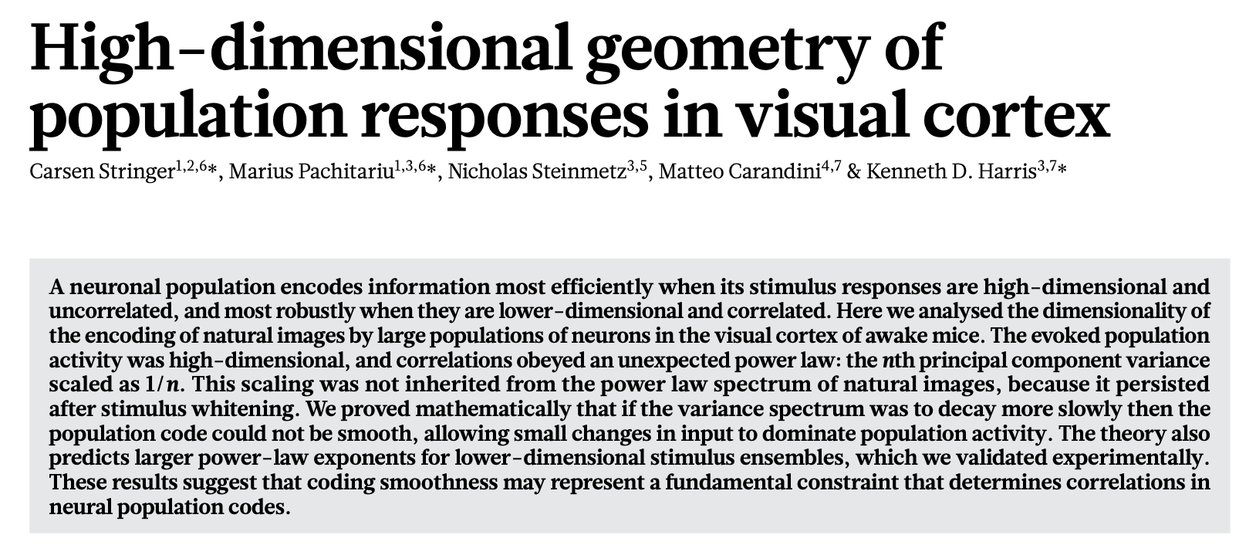
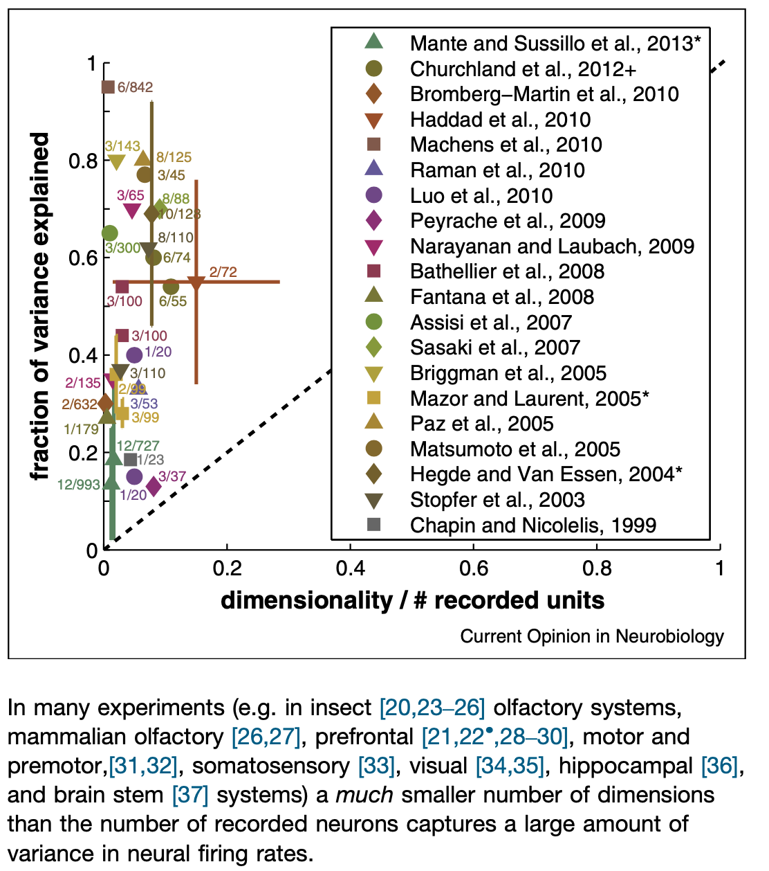
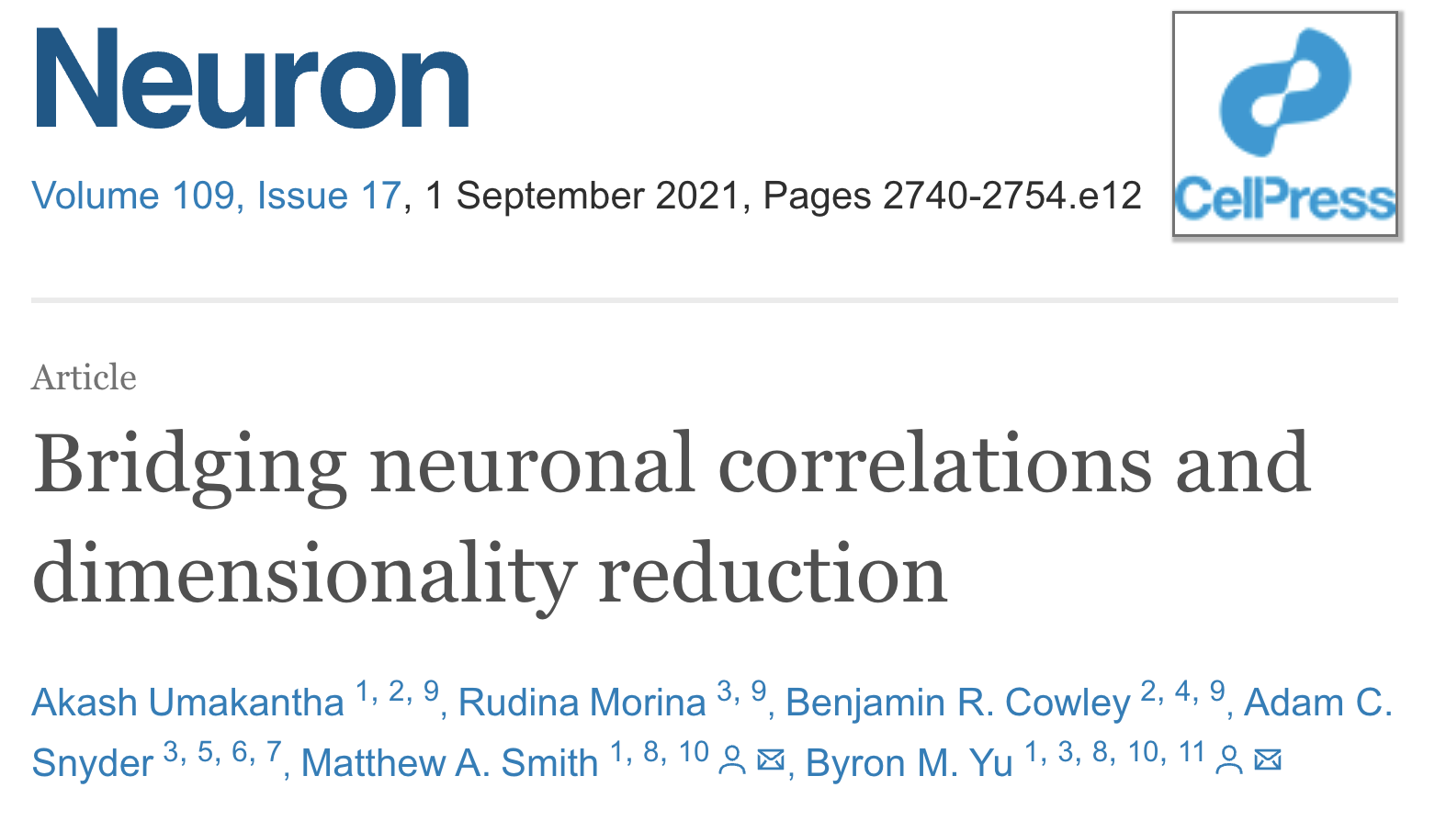


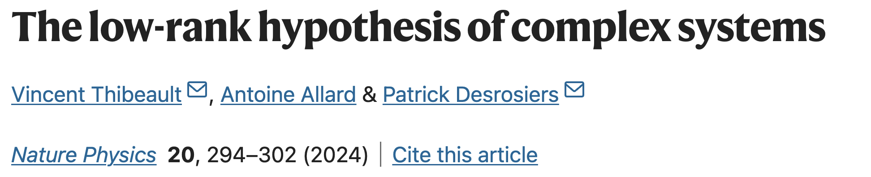
Two important learned lessons from neuroscience and network science:
2. Neuronal activity lies on a low-dimensional manifold

Slide 21
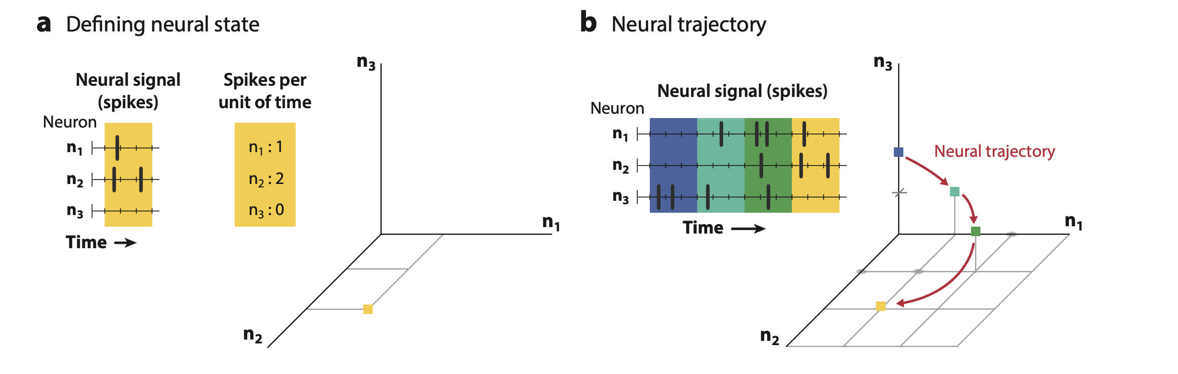
What is the space of the neuronal activity ?
Vyas et al. Annu. Rev. Neurosci. 2020.
In principle, the activity (firing rate) of N neurons spans a space of dimensionality N.

Slide 22
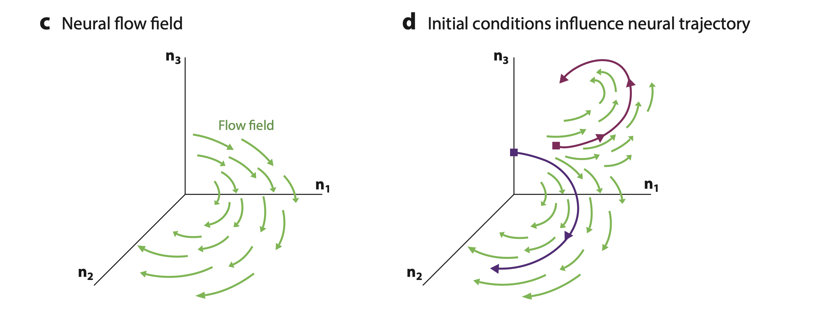
Vyas et al. Annu. Rev. Neurosci. 2020.

Slide 23
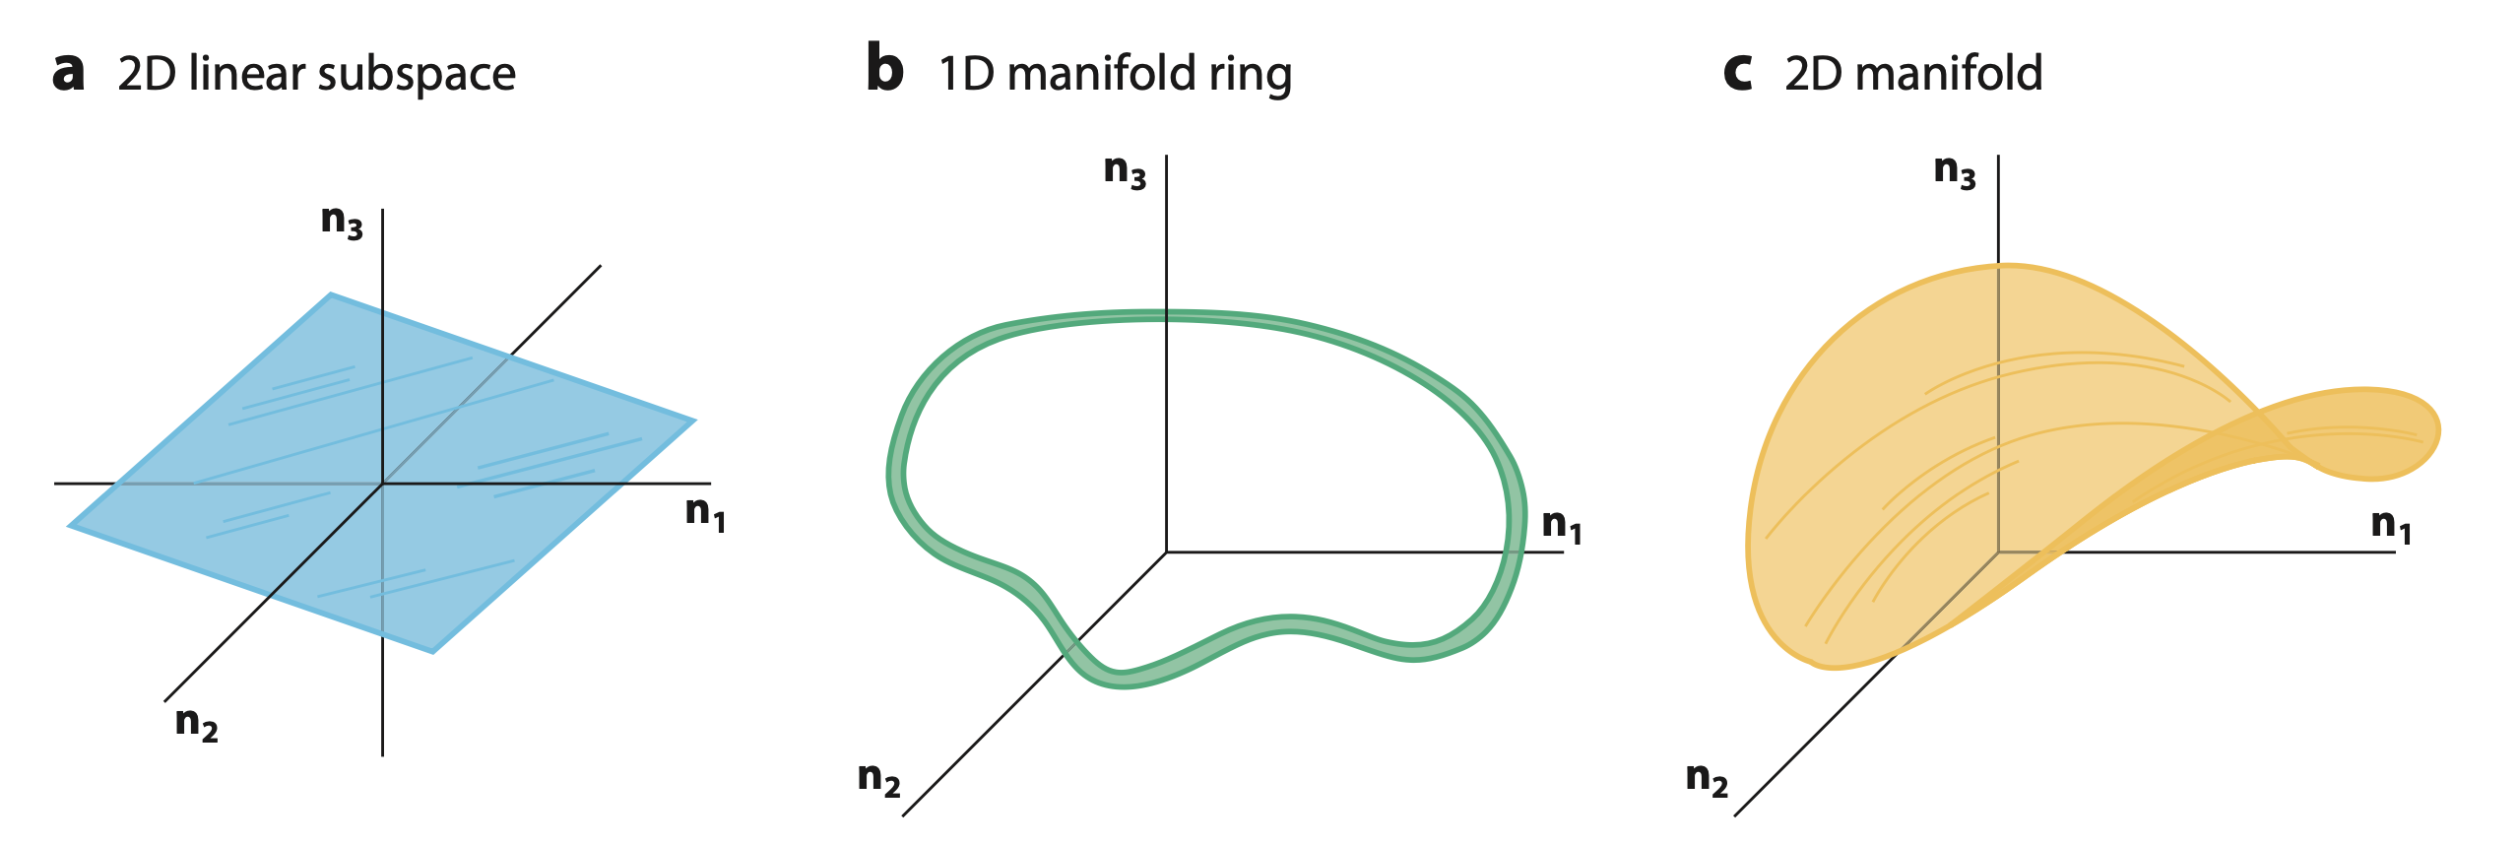
What is the dimension of the neuronal activity ?
Vyas et al. Annu. Rev. Neurosci. 2020.
In a real neuronal network, we expect the dimensionality for $N$ neurons to be n $≪N$.

Slide 24
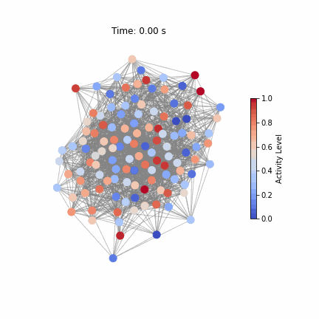
Revealing low dimensional dynamics with PCA
Network structure
Simulated activity
Time series
1d periodic trajectory

Slide 25
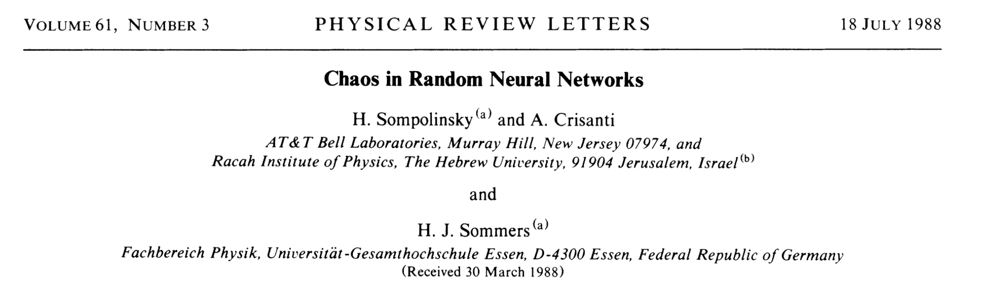
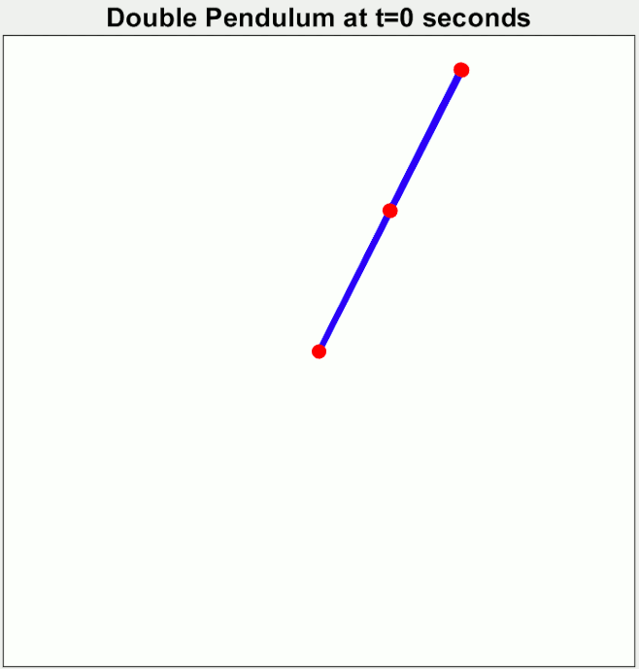
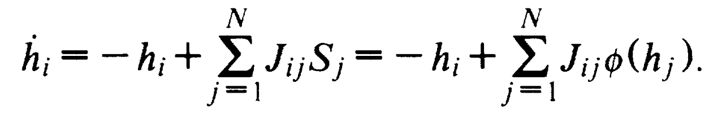
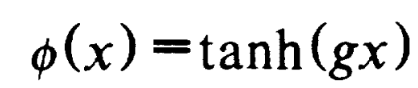
Yet another important behaviour: Chaos!
Chaos: Small differences in initial conditions lead to exponentially diverging outcomes, making long-term prediction impossible despite the system being deterministic.
Random neural networks with strong excitatory inhibitory
connections tend to be chaotic.
Predictability: Does the flap of a butterfly's wing in Brazil set off a tornado in Texas?
Edward Lorenz, American Association for the Advancement of Science, 1972

Slide 26
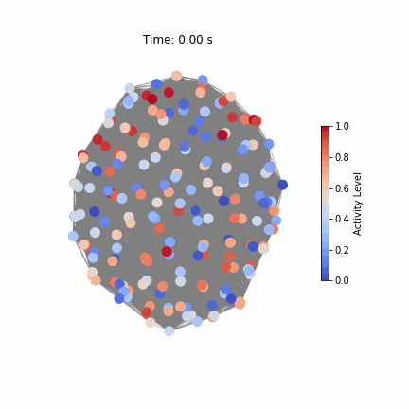
N = 200 neurons

